Slide 1

Meta Optimal Transport
Brandon Amos
Meta AI (FAIR) NYC
Giulia Luise
Microsoft Research
Samuel Cohen
University College London
Meta AI Fairgen
Ievgen Redko
Noah’s Ark Lab, Huawei Aalto University
http://github.com/bamos/presentations http://github.com/facebookresearch/meta-ot

Slide 2
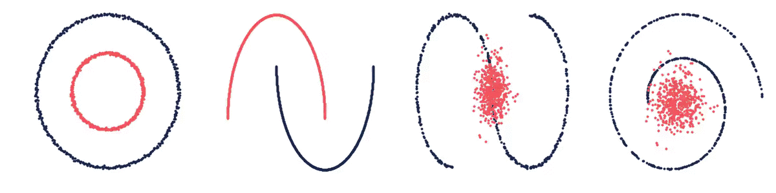
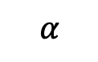
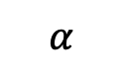
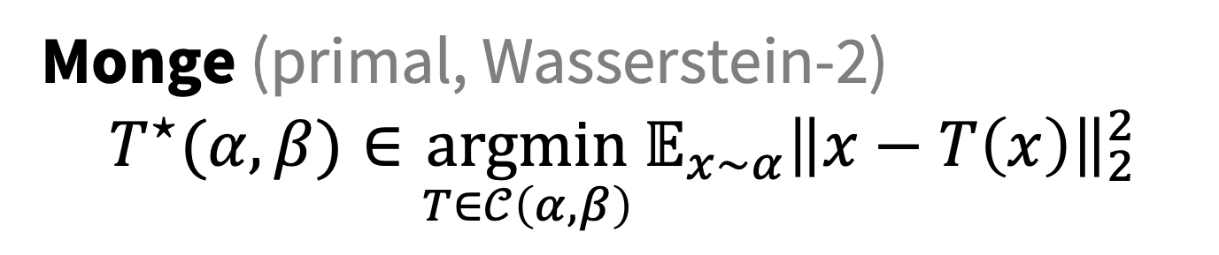
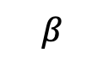
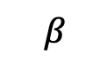
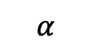
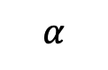
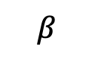
Optimal transport connects spaces
Monge (primal, Wasserstein-2)
$${T^{⋆}(α, β)∈\underset{T∈𝒞\left(α, β\right)}{argmin}{𝔼_{x∼α}\left\|x−T\left(x\right)\right\|}}_{2}^{2}$$
$α,β$ are measures $𝒞\left(α, β\right)$ is the set of valid couplings $T$ is a transport map from $α$ to $β$
we also consider other/discrete OT formulations
$$β$$
$$α$$
$$β$$
$$α$$
$$α$$
$$α$$
$$β$$
$$β$$

Slide 3
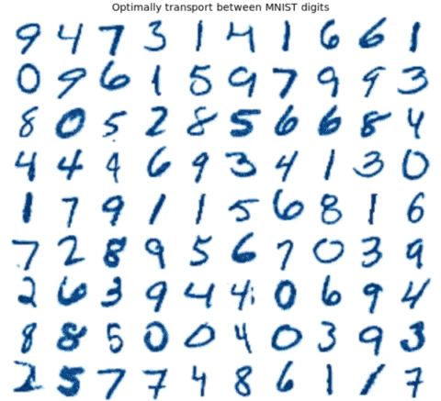
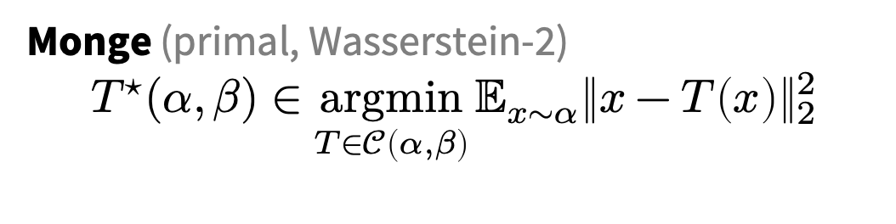
Challenge: computing OT maps
Monge (primal, Wasserstein-2)
$${T^{⋆}(α, β)∈\underset{T∈𝒞\left(α, β\right)}{argmin}{𝔼_{x∼α}\left\|x−T\left(x\right)\right\|}}_{2}^{2}$$
we also consider other/discrete OT formulations
Many OT problems are numerically solved
Improving OT solvers is active research
Solving multiple OT problems: even harder
Standard solution: independently solve

Slide 4
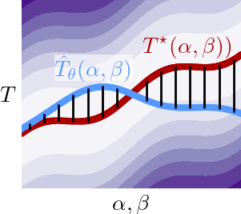
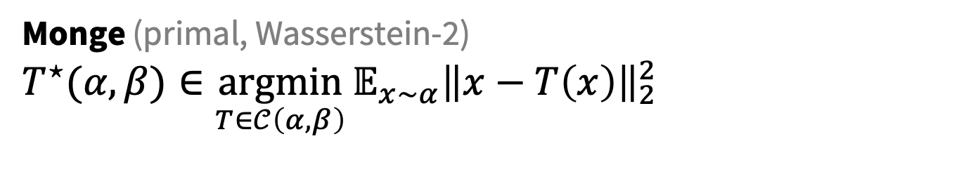

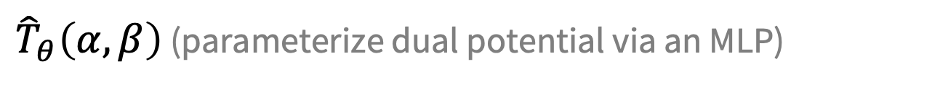
Meta Optimal Transport
Tutorial on amortized optimization. Brandon Amos. Foundations and Trends in ML, 2023.
Idea: predict the solution to OT problems with amortized optimization
Simultaneously solve many OT problems, sharing info between instances
Monge (primal, Wasserstein-2)
$${T^{⋆}(α, β)∈\underset{T∈𝒞\left(α, β\right)}{argmin}{𝔼_{x∼α}\left\|x−T\left(x\right)\right\|}}_{2}^{2}$$
$$≈$$
${\hat{T}}_{θ}\left(α, β\right)$ (parameterize dual potential via an MLP)
we also consider other/discrete OT formulations

Slide 5
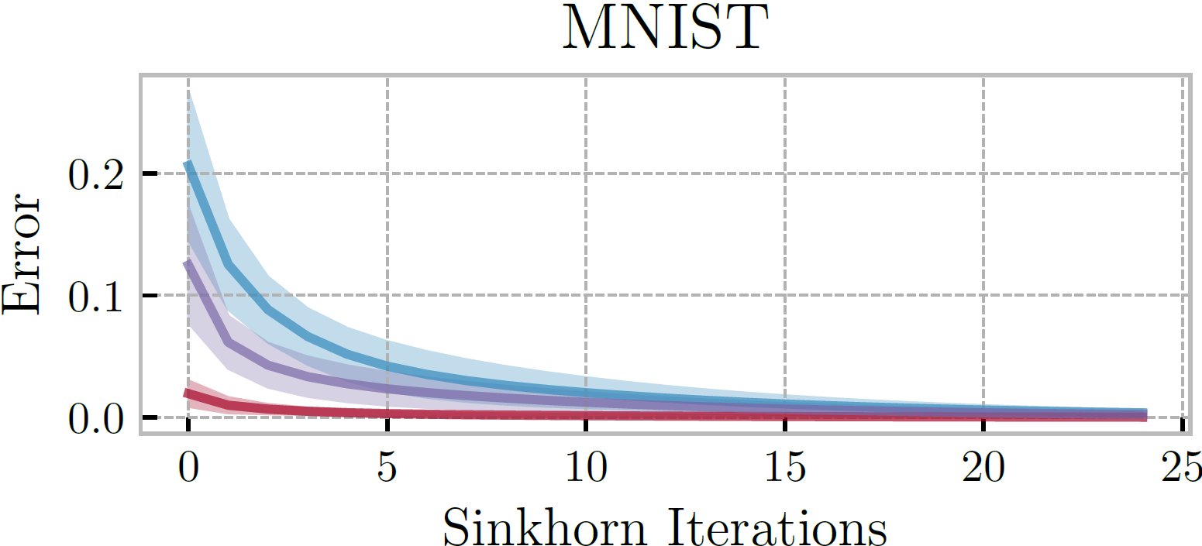
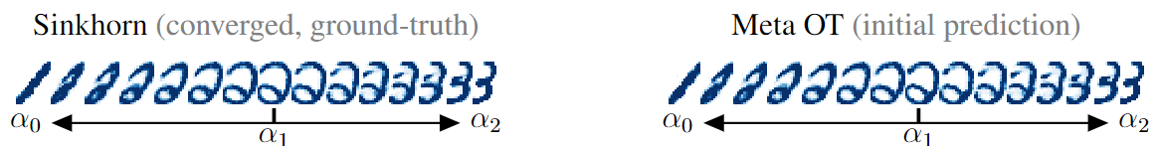
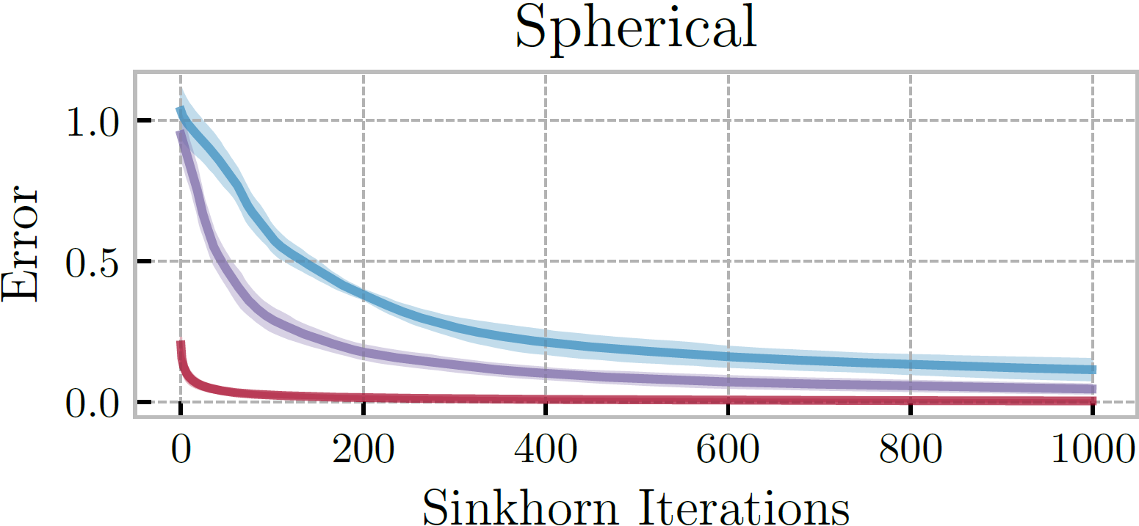
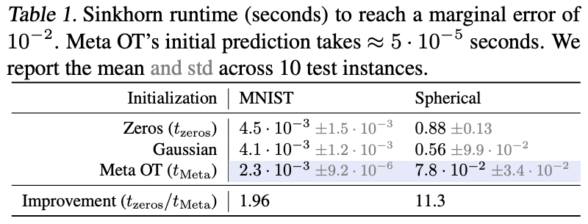
Meta OT for Discrete OT (Sinkhorn)
Sinkhorn Distances: Lightspeed Computation of Optimal Transport. Marco Cuturi. NeurIPS 2013.

Slide 6
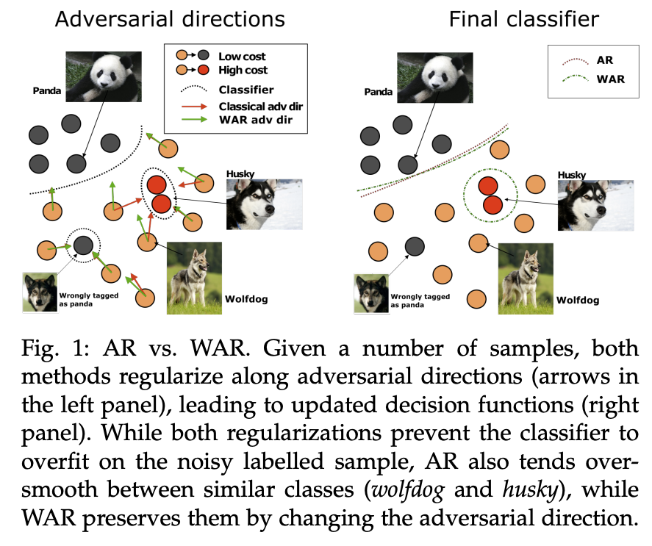
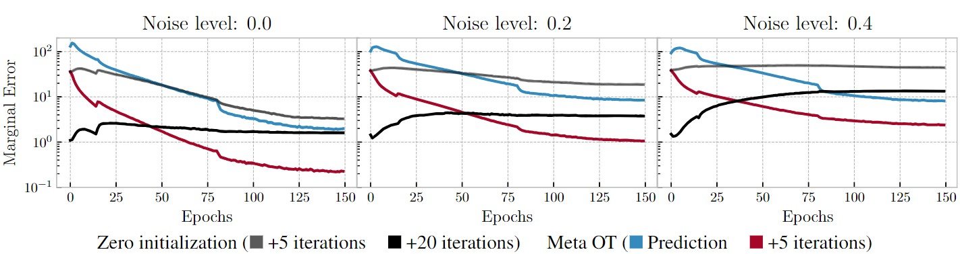
Wasserstein adversarial regularization
Wasserstein adversarial regularization for learning with label noise. Kilian Fatras et al., TPAMI 2021.
Setting: Discrete OT for classification with label noise
OT is repeatedly solved across minibatches
Use Meta OT to learn better solutions

Slide 7
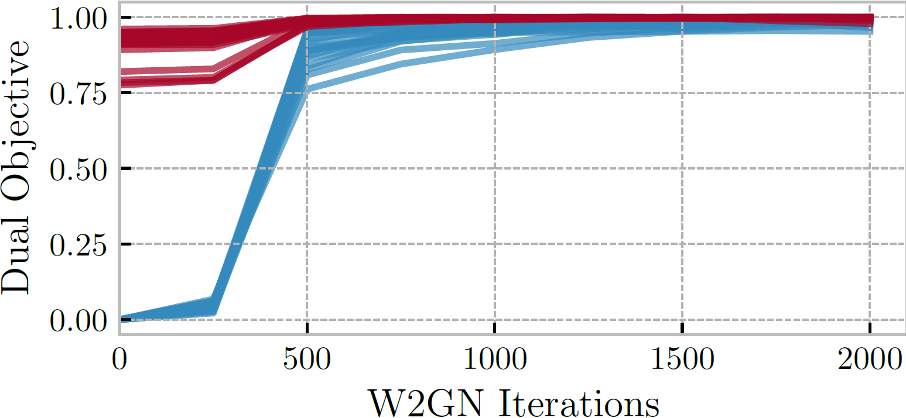
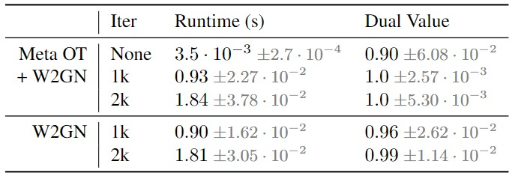
Meta OT in continuous settings (W2GN)
Wasserstein-2 Generative Networks. Alexander Korotin et al., ICLR 2021.
RGB color palette transport

Slide 8
More Meta OT color transfer predictions

Slide 9
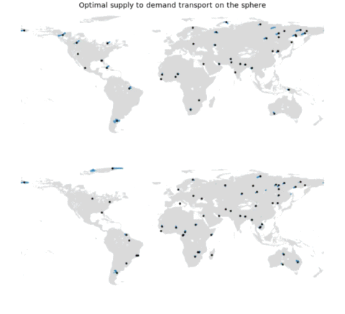
Conclusions
Deploying OT in real applications will almost always result in repeated solves
Use Meta OT and amortized optimization to learn a better solver

Slide 10
Meta Optimal Transport
Brandon Amos
Meta AI (FAIR) NYC
Giulia Luise
Microsoft Research
Samuel Cohen
University College London
Meta AI Fairgen
Ievgen Redko
Noah’s Ark Lab, Huawei Aalto University
http://github.com/bamos/presentations http://github.com/facebookresearch/meta-ot

